Slide 1
PYTHON
Module 7
FUNCTIONS
Presentation by: Gopinath.G

Slide 2
Python Functions
Simple definition:
A function is a block of code which only runs when it is called.
You can pass data, known as parameters, into a function.
A function can return data as a result.
Python Functions is a block of statements that return the specific task. The idea is to put some commonly or repeatedly done tasks together and make a function so that instead of writing the same code again and again for different inputs, we can do the function calls to reuse code contained in it over and over again.
Advantages:
Increase Code Readability
Increase Code Reusability

Slide 3
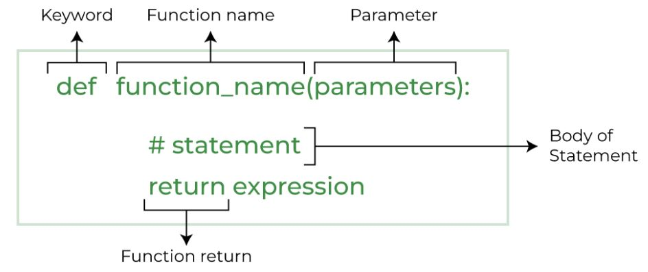
Syntax:
Types of Functions in Python
Built-in library function: These are Standard functions in Python that are available to use.
User-defined function: We can create our own functions based on our requirements.

Slide 4
Creating a Function in Python
We can create a user-defined function in Python, using the def keyword. We can add any type of functionalities and properties to it as we require.
Calling a Python Function
After creating a function in Python we can call it by using the name of the function followed by parenthesis containing parameters of that particular function.
Example program
Python Function with Parameters
If you have experience in C/C++ or Java then you must be thinking about the return type of the function and data type of arguments. That is possible in Python as well (specifically for Python 3.5 and above).
Defining and calling a function with parameters
def function_name(parameter: data_type) -> return_type:
"""Docstring"""
# body of the function
return expression
Example program

Slide 5
Python Function Arguments
Arguments are the values passed inside the parenthesis of the function. A function can have any number of arguments separated by a comma.
Types of Python Function Arguments
Python supports various types of arguments that can be passed at the time of the function call. In Python, we have the following 4 types of function arguments.
Default argument
Keyword arguments (named arguments)
Positional arguments
Arbitrary arguments
Example program for each

Slide 6
Python Function within Functions
A function that is defined inside another function is known as the inner function or nested function. Nested functions are able to access variables of the enclosing scope. Inner functions are used so that they can be protected from everything happening outside the function.
Example program

Slide 7
Return Statement in Python Function
The function return statement is used to exit from a function and go back to the function caller and return the specified value or data item to the caller. The syntax for the return statement is:
return [expression_list]
The return statement can consist of a variable, an expression, or a constant which is returned at the end of the function execution. If none of the above is present with the return statement a None object is returned.
Example program

Slide 8
Pass by Reference and Pass by Value
One important thing to note is, in Python every variable name is a reference. When we pass a variable to a function, a new reference to the object is created. Parameter passing in Python is the same as reference passing in Java.
Example program

Slide 9
Recursion
Python also accepts function recursion, which means a defined function can call itself.
Recursion is a common mathematical and programming concept. It means that a function calls itself. This has the benefit of meaning that you can loop through data to reach a result.
The developer should be very careful with recursion as it can be quite easy to slip into writing a function which never terminates, or one that uses excess amounts of memory or processor power. However, when written correctly recursion can be a very efficient and mathematically-elegant approach to programming.
Example

Slide 10
Python Lambda
A lambda function is a small anonymous function.
A lambda function can take any number of arguments, but can only have one expression
Syntax:
lambda arguments : expression
The expression is executed and the result is returned
Lambda functions can take any number of arguments
Why Use Lambda Functions?
The power of lambda is better shown when you use them as an anonymous function inside another function.
def myfunc(n): return lambda a : a * n
you have a function definition that takes one argument, and that argument will be multiplied with an unknown number
Use that function definition to make a function that always doubles the number you send in.

Slide 11
Use that function definition to make a function that always doubles the number you send in.
Or, use the same function definition to make both functions, in the same program
Use lambda functions when an anonymous function is required for a short period of time.
EXAMPLE FOR LAMBDA FUNCTION

Slide 12
THANKYOU..!

